Slide 1
React.JS
Lecture 20
Starting React

Slide 2
React.JS
ReactJS is an open-source, component based front end library responsible only for the view layer of the application.
It is maintained by Facebook.
ReactJS uses virtual DOM based mechanism to fill in data (views) in HTML DOM.

Slide 3
What we will cover
Components(Functional/Class Based)
Props
States
Lifecycle Hooks
Using React Strap/Bootstrap
React Routing
Controlled and Uncontrolled Forms
Fetch/Axio REST API Call
Usage of Redux with React

Slide 4
Concepts of Reacts.JS
Virtual DOM
Components
Props
States
React Component Lifecycle
Routing
Redux

Slide 5
Virtual DOM
The virtual DOM is an in-memory representation of an actual DOM.
The virtual DOM works fast owning to the fact that it only changes individual DOM elements instead of reloading complete DOM every time.
By doing most of the processing inside the virtual DOM rather than directly in the browser's DOM, React can act quickly and only add, update, and remove components which have changed since the last render cycle occurred.

Slide 6
Component
As React concerns itself only with an application's view, the bulk of development in React will be the creation of components.
A component represents a portion of the view of your application.
It can be useful to think of React components as simple functions - they take input in the form of "props", and produce output as markup.

Slide 7
Components
A React application is made up of multiple components, each responsible for outputting a small, reusable piece of HTML.
Components can be nested within other components to allow complex applications to be built out of simple building blocks.
A component may also maintain internal state.
for example, a TabList component may store a variable corresponding to the currently open tab.

Slide 8
ReactJS
React allows us to write components using a domain-specific language called JSX.
JSX allows us to write our components using HTML, whilst mixing in JavaScript events.
React will internally convert this into a virtual DOM, and will ultimately output our HTML for us.
React "reacts" to state changes in your components quickly and automatically to re-render the components in the HTML DOM by utilizing the virtual DOM.

Slide 9
With JSX
A React component — in its simplest form — is a plain-old JavaScript function:
// Example 1
// https://jscomplete.com/repl?j=Sy3QAdKHW
function Button (props) {
// Returns a DOM element here. For example:
return <button type="submit">{props.label}</button>;
}
// To render the Button component to the browser
ReactDOM.render(<Button label="Save" />, mountNode)

Slide 10
Without JSX
// Example 2 - React component without JSX
function Button (props) {
return React.createElement(
"button",
{ type: "submit" },
props.label
);
}
// To use Button, you would do something like
ReactDOM.render(
React.createElement(Button, { label: "Save" }),
mountNode
);

Slide 11
Props
"Props" are simply the attributes used on a JSX node (e.g. <SomeComponent someProp="some prop's value" />), and are the primary way our application interacts with our components.
In the snippet above, inside of SomeComponent, we would have access to this.props, whose value would be the object {someProp: "some prop's value"}.
Props are a way to pass information into a React component, they can have any type including functions - sometimes referred to as callbacks.
In JSX props are passed with the attribute syntax

Slide 12
Props
react props are immutable once they have been passed in, meaning they cannot be modified from within a component.
If the parent of a component changes the value of a prop, React handles replacing the old props with the new, the component will re-render itself using the new values.

Slide 13
Props
// In React
const MyComponent = props => {
return <h1>Hello, {props.name}!</h1>;
};
ReactDOM.render(<MyComponent name=“Rashid" />, element);
// Will render <h1>Hello, Rashid!</h1>

Slide 14
States
State in React components is essential to manage and communicate data in your application.
It is represented as a JavaScript object and has component level scope, it can be thought of as the private data of your component.
It is the responsibility of this component to store the data within its state, and distribute the data to other components via props.

Slide 15
State Example
In Constructor, we define states
this.state = {
name: firstName
}
Accesing within Class:
This.state.name
Setting State:
this.setState((state, props) => {
return {counter: state.counter + props.step};
});

Slide 16
Component LifeCycle
Lifecycle methods are to be used to run code and interact with your component at different points in the components life.
These methods are based around a component Mounting, Updating, and Unmounting.
More Common
constructor()
render()
componentDidMount()
getDerivedStateFromProps()
componentDidUpdate()

Slide 17
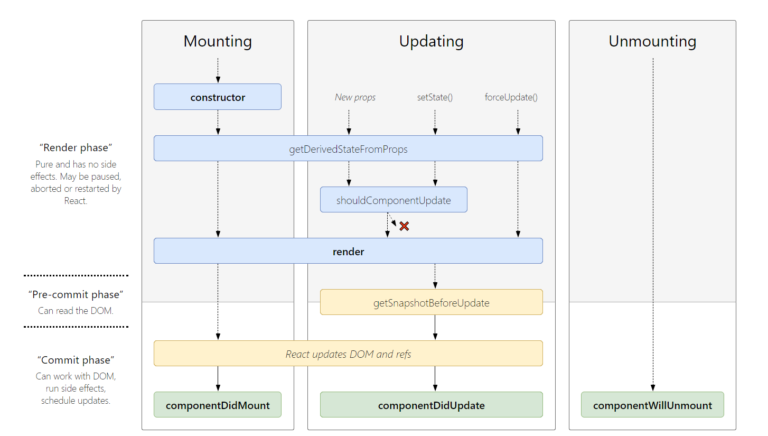
Cycle

Slide 18
Routing
Place a file like the following in your top level directory. It defines which components to render for which paths.
<Route path="/" component={App}>
<IndexRoute component={Index} />
<Route path="posts/new" component={New} />
<Route path="posts/:id" component={Show} />
</Route>
Now in your top level index.js that is your entry point to the app, you need only render this Router component.
Now it is simply a matter of using Link instead of <a> tags throughout your application.
Using Link will communicate with React Router to change the React Router route to the specified link, which will in turn render the correct component as defined in routes.js

Slide 19
Redux
we need to stress that Redux has no relation to React. You can write Redux apps with React, Angular, Ember, jQuery, or vanilla JavaScript.
That said, Redux works especially well with libraries like React and Deku because they let you describe UI as a function of state, and Redux emits state updates in response to actions.
We will cover in a separate lecture

